Slide 1
High Fidelity Wind Farm Simulation Automation
Sydney Richardson
Mentor: Ashesh Sharma
GEM Fellow @ NWTC
08/04/2023

Slide 2
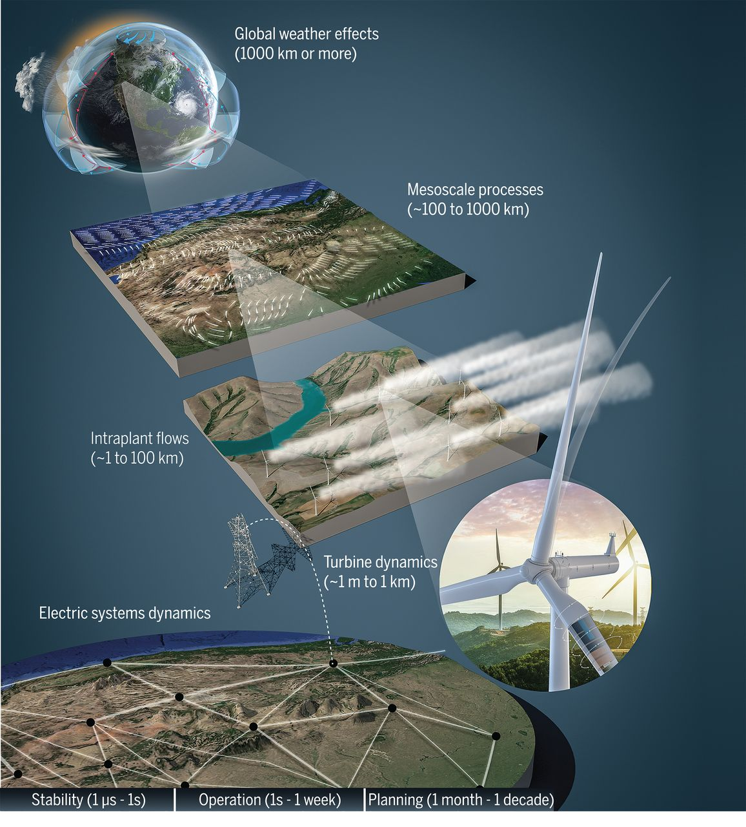
Motivation for high-fidelity wind models
Want more wind energy at low cost
Wind dynamics and coupled turbine structural dynamics are complex and models are lacking
Relevant dynamics span many orders of magnitude
We can optimize the system when we understand the system
Maximize energy extraction
Maximize turbine life, minimize downtime
Grand challenges in the science of wind energy Veers, P. et al., 2019 Science, Vol. 366, Issue 6464
https://science.sciencemag.org/content/366/6464/eaau2027
Notes:
Stage the problem:
Modern wind turbines are "largest dynamic, rotating machines in the world”;
The range of scales and the variety of physics and systems is daunting; rotor diameters are approaching 200 m

Slide 3
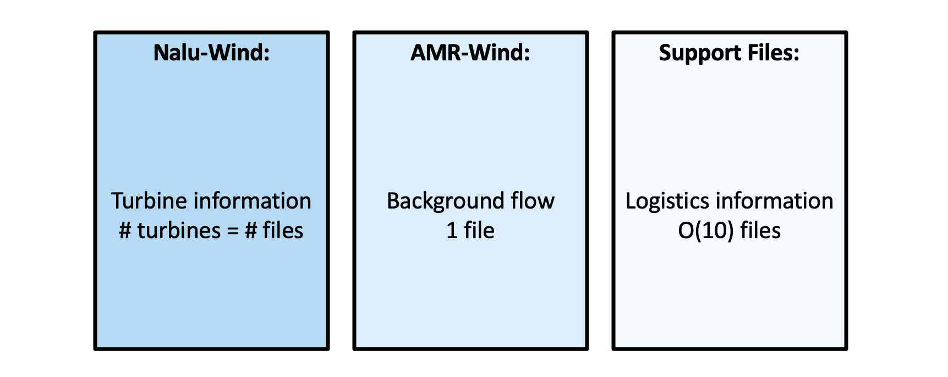
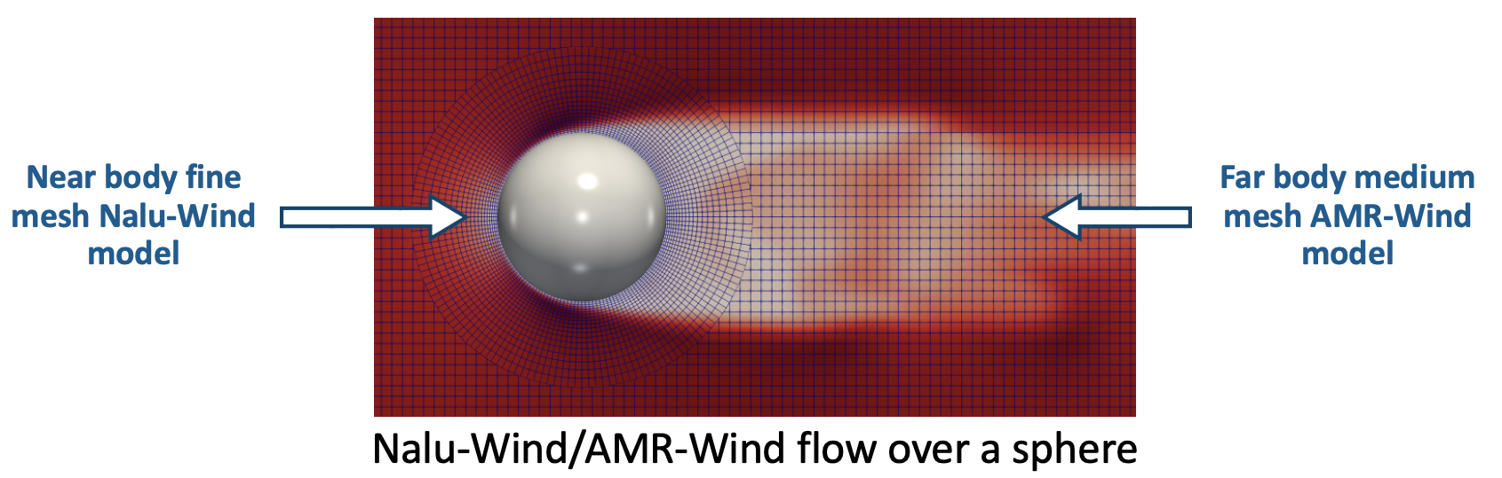
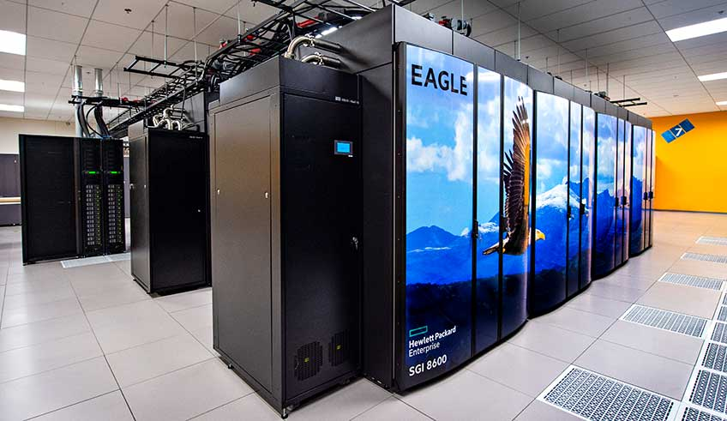
ExaWind hybrid solver: AMR-Wind + Nalu-Wind
ExaWind: An open-source multi-fidelity modeling & simulation software designed to run on laptops and next-gen supercomputers
Nalu-Wind and AMR-Wind are coupled in the ExaWind simulation
Provides “optimal” solvers for the different grids
Manually created
100 turbines = 100 files

Slide 4
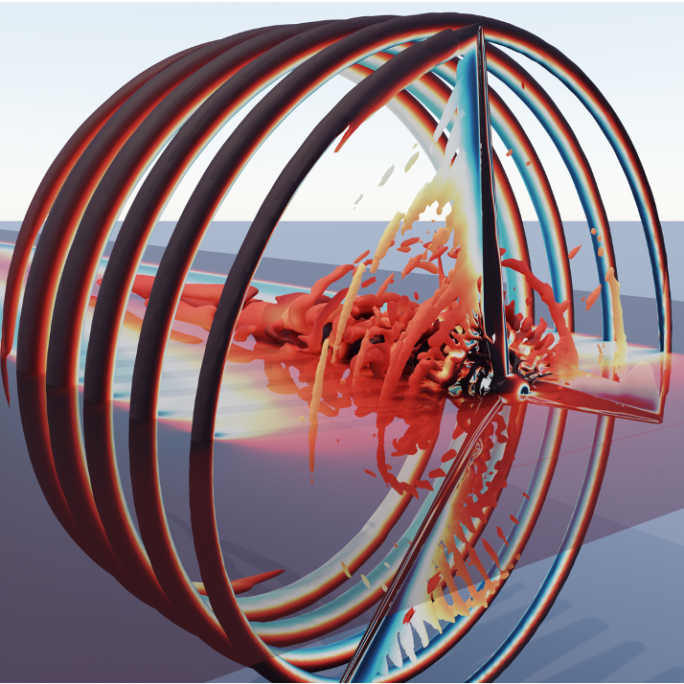
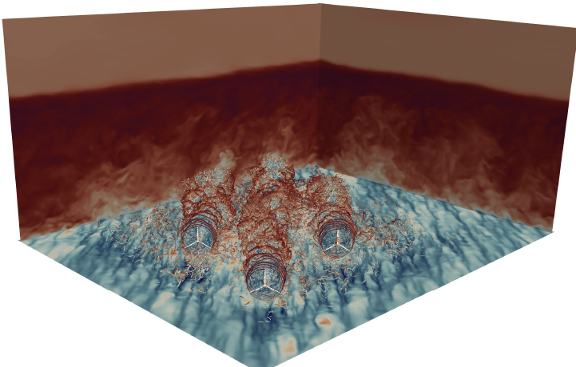
My Goal
Make this complex simulation more accessible to users of different backgrounds via simplification

Slide 5

Mesh conditions
Better documentation
Simulation cohesion
Error checking
Visualization tools
Post processing
No GUI!
GUI
Crashing issues
Inflow conditions
Parameter definition
Time step issues
Developer
Beginner
AMR
only
NREL
user
Expert
Outside
user
Notes:
Stake holders of this software

Slide 6
Automation
Input files
Parameter definition
Error checking

Slide 7
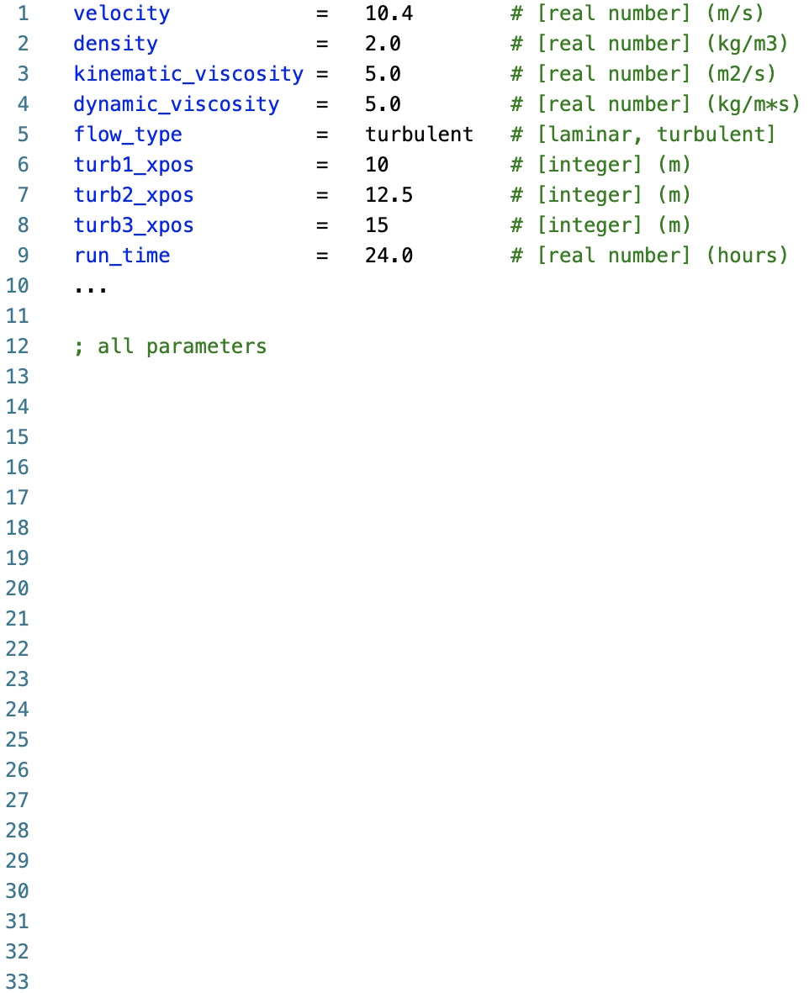
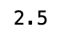
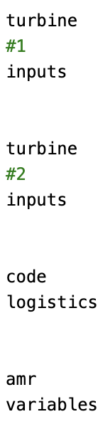

ExaWind Automation
ExaWind Base File
Parameters have units if applicable, valid parameter options to choose from, and a description of usage
Submit Job File
Setup Flow File
Transformation
code
Turbine File 1
Turbine File 2...
Error
check
Notes:
this is the error catch this is what the transformed file looks like like adding more error catching problems, inconsistent setup
Include error that is physics based: say density is 1 but viscosity doesn’t agree
Switch to exawind example
Explicitly mention automated file generation into multiple turbine files

Slide 8



C o n c l u s i o n s
Increasing accessibility to ExaWind solver
Allowing more researchers to investigate wind energy
Contributing to the global fight against climate change

